Slide 1
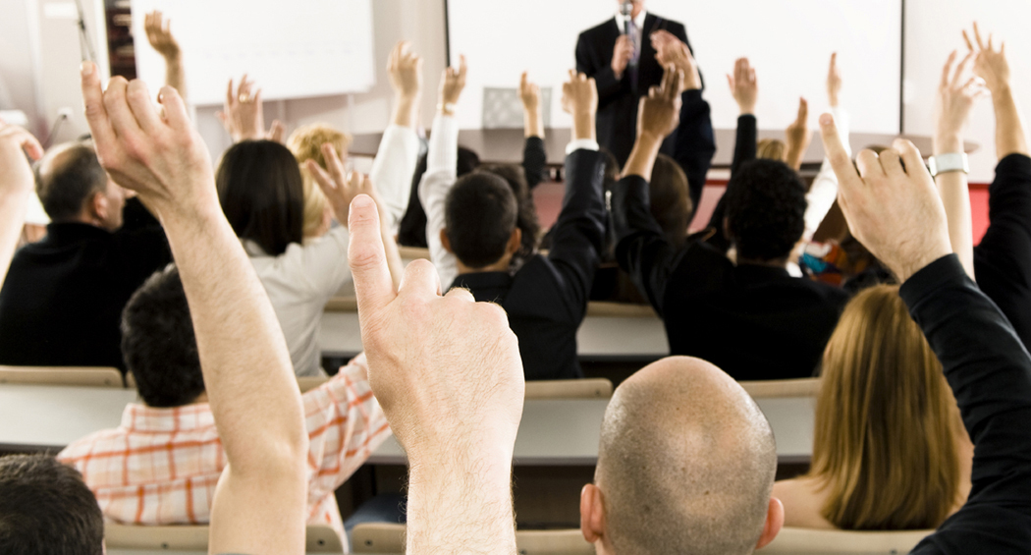
Hands and Cards

Slide 2
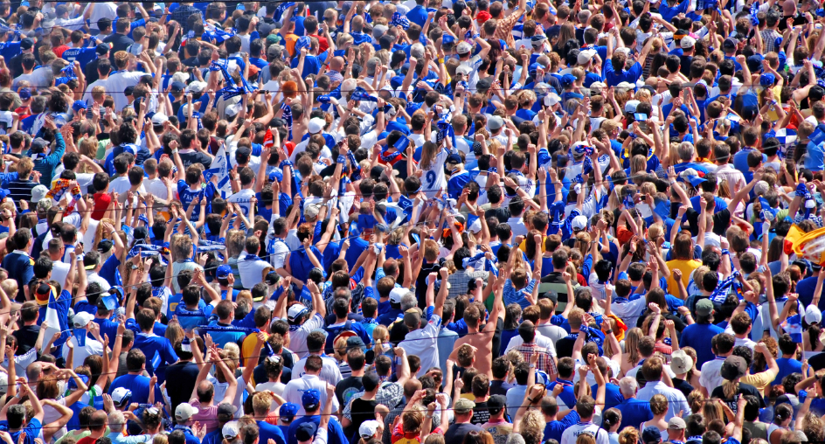
Question 1
What do you call that sound that’s made when many people slap their hands together at the same time?

Slide 3
Question 2
What do you call those paper holders for birthday cards and letters?

Slide 4
Question 3
What do you call those roundish things that only break when they are filled up with too much air?

Slide 5
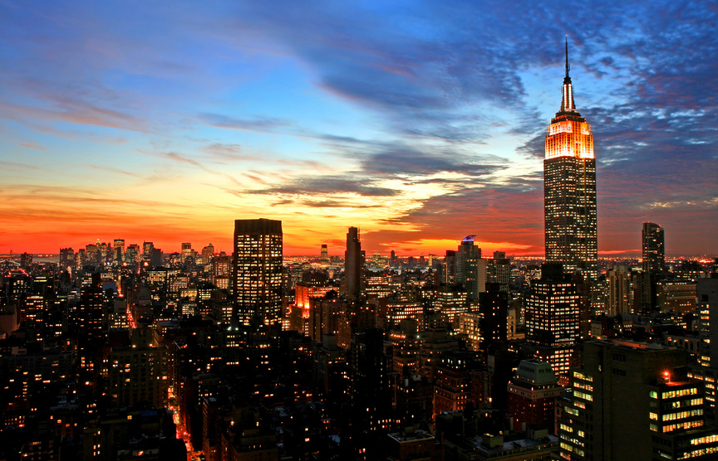
Question 4
What do you call those boxes that people ride up or down in when they’re inside of buildings?

Slide 6
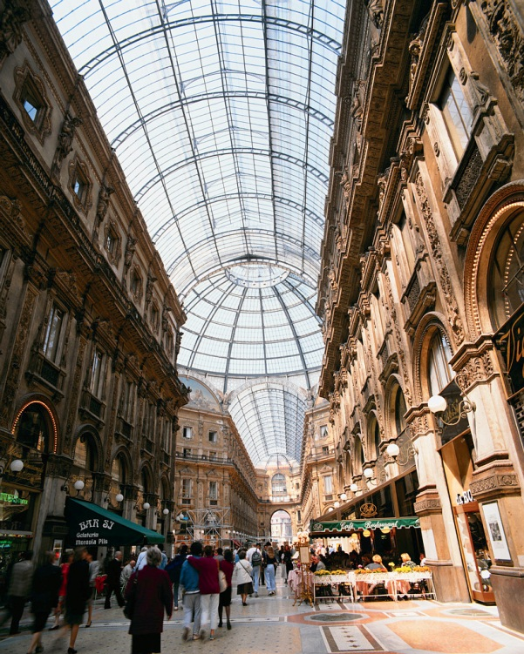
Question 5
Write a question that can be answered with the word “mall.”
Your question must start with the words below:
  Why do you call that….___________________?

Slide 7
Question 6
What do you call those things that people wear on their fingers?

Slide 8
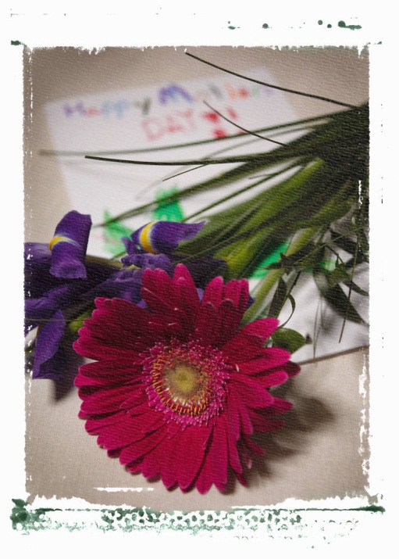
Question 7
When was the last time you sent someone a card? Why did you send it to them?

Slide 9
Question 8
What is something that you can make with your hands?

Slide 10
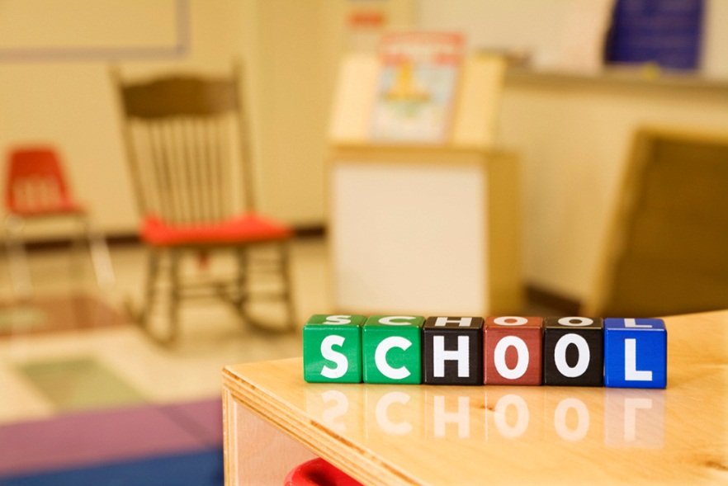
Question 9
What is that thing you need to put on an envelope so the Post Office will deliver it?

Slide 11
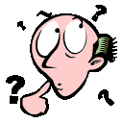
Question 10
What is this week’s most difficult spelling word to spell?

