Slide 1
How To Use Twitter as a Teacher
Grow your PLN
Positive Classroom PR
With other teachers
With the district
With parents
Connect with other Classrooms
Connect with Students
Share content knowledge

Slide 2
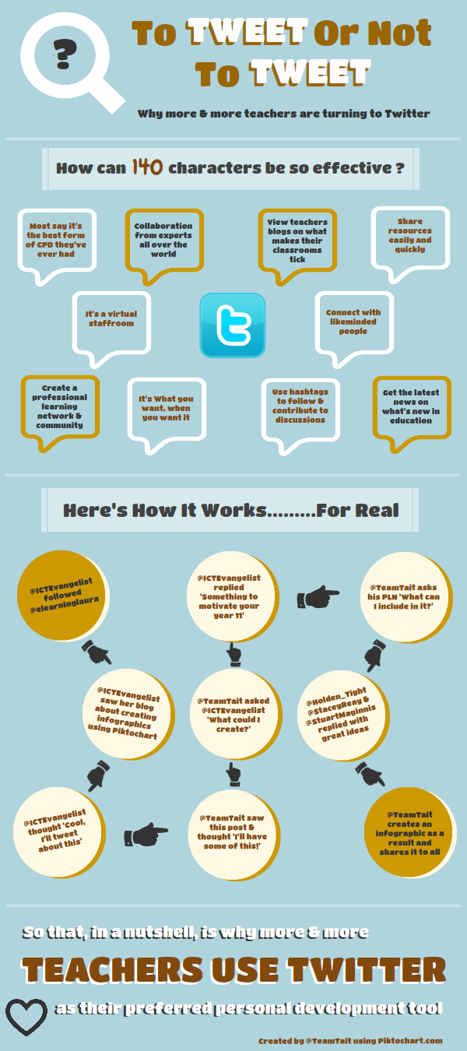

Slide 3
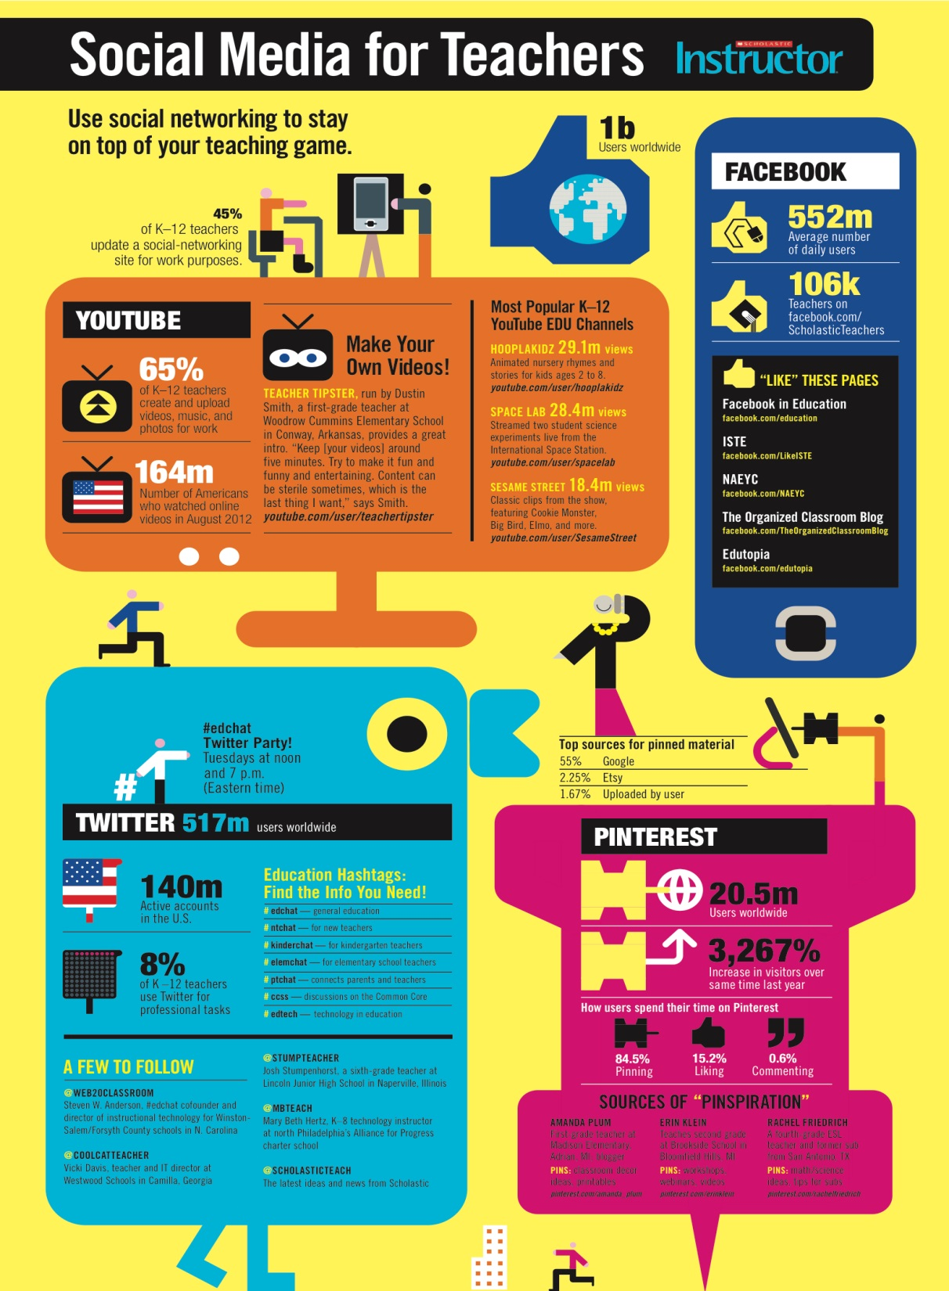

Slide 4
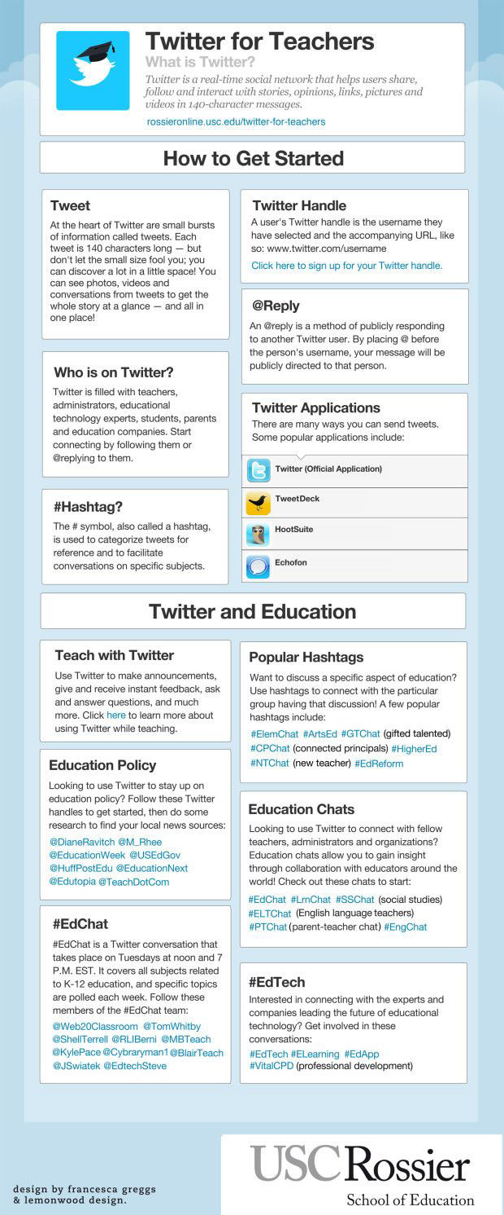

Slide 5
