Slide 1
Kidnap

Slide 2
How to Solve the Mystery
Always read the story first. It supplies you with vital clues.
Read all the questions through without trying to answer them. This will give you a sense of what to look for in the picture.
Examine the picture.
Answer the questions, one at a time and in order.
Find out the solution and either congratulate yourself or do better next time!

Slide 3
The Information
Sketch A shows eight-year-old William’s room as it was just before his living mother put him to bed for his afternoon nap, and Sketch B shows the room as it was an hour later, after she’d finished her daily meditation and reported to Sergeant Foxxy that William was missing. Foxxy made a preliminary examination, concluded that William had been kidnapped, and listed the following suspects:
William’s loving father, who was having a custody fight with William’s loving mother and had threatened to abduct his son.
Marth Soul, who had been William’s loving nurse for the past several years, but had had to leave a week ago because William’s loving mother could no longer afford a nurse.
Mr. Green, the gardener who had been working her for the last three months.
William’s loving mother.
Which one of the four do you think Foxxy should accuse?

Slide 4
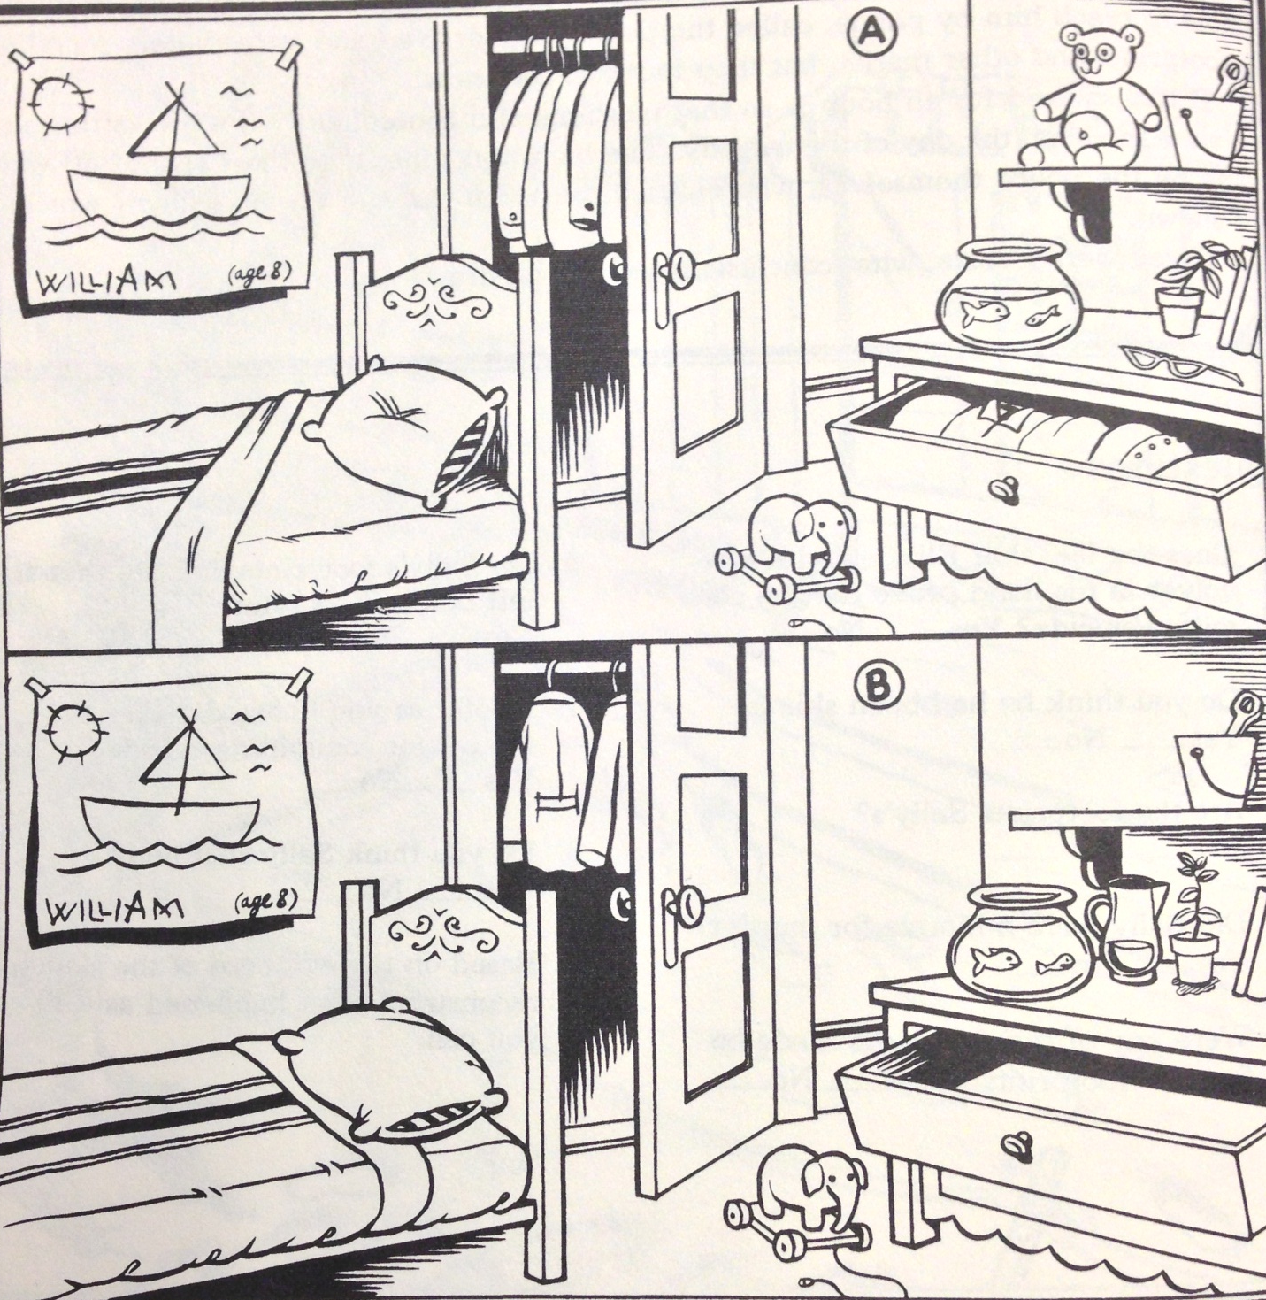
The Scene

Slide 5
The Questions
Possible suspects:
William’s Father
Martha Soul, nurse
Mr. Green, gardener
William’s mother
Type your answers next to the questions.
HINT: Remember the “Find the Differences” pictures you did when you were younger? Spot all the differences in the two pictures first.
Did young William leave willingly? Yes or no? How do you know?
Answer:
Was young William neat and tidy? Yes or no?
Answer:
Did young William’s loving mother have a motive for taking him from his room?
Answer:

Slide 6
The Questions
Possible suspects:
William’s Father
Martha Soul, nurse
Mr. Green, gardener
William’s mother
Type your answers next to the questions.
Did his loving father have a motive for kidnapping him?
Answer:
Did the gardener have a motive for kidnapping him?
Answer:
Did his loving nurse have a motive for kidnapping him?
Answer:
Did the kidnapper water the plant? Yes or no?
Answer:

Slide 7
The Questions
Possible suspects:
William’s Father
Martha Soul, nurse
Mr. Green, gardener
William’s mother
Type your answers next to the questions.
Was the kidnapper familiar with the house? Yes or no?
Answer:
Did the kidnapper intend to hold William for more than a day or two? Yes or no? How do you know?
Answer:
Was the loving mother likely to hear the kidnapper at work?
Answer:

Slide 8
The Questions
Possible suspects:
William’s Father
Martha Soul, nurse
Mr. Green, gardener
William’s mother
Type your answers next to the questions.
Do you think the loving father kidnapped William?
Answer:
Do you think the gardener kidnapped William?
Answer:
Do you think William’s mother was the kidnapper and that she put William where his loving father couldn’t find him?
Answer:
Do you think William’s loving nurse kidnapped him?
Answer:

Slide 9
Your Solution
Possible suspects:
William’s Father
Martha Soul, nurse
Mr. Green, gardener
William’s mother
Who do you think kidnapped William? Why do you think that?

