Slide 1
The Van Bliven Necklace

Slide 2
How to Solve the Mystery
Always read the story first. It supplies you with vital clues.
Read all the questions through without trying to answer them. This will give you a sense of what to look for in the picture.
Examine the picture.
Answer the questions, one at a time and in order.
Find out the solution and either congratulate yourself or do better next time!

Slide 3
The Information
Mrs. Van Bliven loved caviar and bubble baths, and indulged herself accordingly. Part of her hotel room is shown, both before and after the disappearance of her $25,000.00 necklace. She said she’d locked her door and taken her bubble bath at seven o’clock, and she denied that the phone had run, although the operator stated that it had.
The police searched three suspects and their belongings, and found nothing. The suspects were: Mrs. Van Bliven; Emmy, the pert little chambermaid; and Honore Schmidt, who had an adjacent room which shared Mrs. Van Bliven’s balcony.
Whom would you arrest for the theft, and what do you think happened to the necklace?

Slide 4
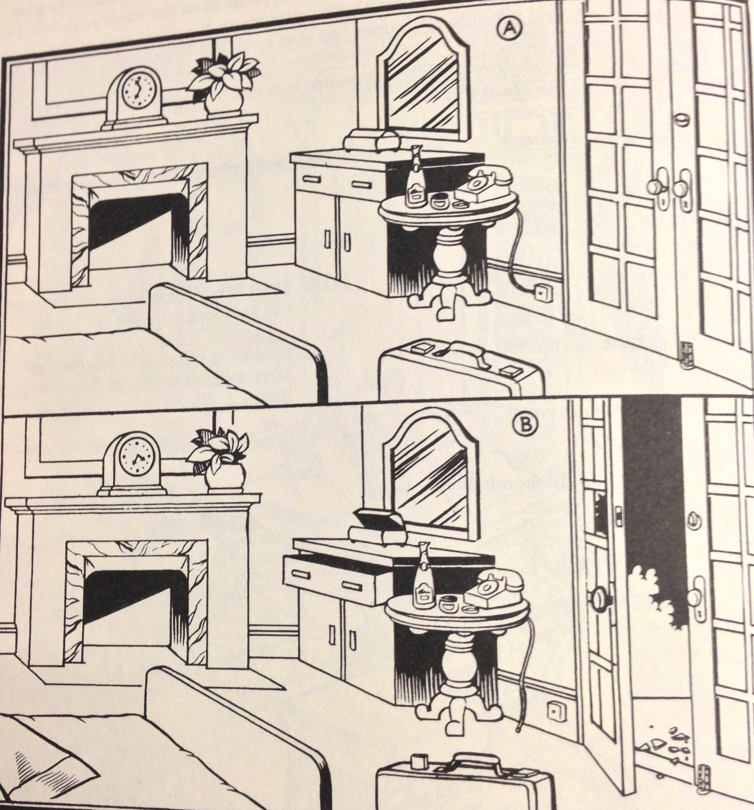
The Scene

Slide 5
The Questions
Possible suspects:
Mrs. Van Bliven
Emmy, the maid
Honore Schmidt, next door
Type your answers next to the questions.
HINT: Remember the “Find the Differences” pictures you did when you were younger? Spot all the differences in the two pictures first.
Which picture shows the room before the theft? A or b? How do you know that?
Answer:
Was Mrs. Van Bliven traveling?
Answer:
What three objects were searched by the criminal?
Answer:
Is Mrs. Van Bliven’s denial of the phone call incriminating?
Answer:

Slide 6
The Questions
Possible suspects:
Mrs. Van Bliven
Emmy, the maid
Honore Schmidt, next door
Type your answers next to the questions.
Was the pane of glass broken from outside? Yes or no. How can you tell?
Answer:
Could Schmidt have entered through the patio doors? Yes or no?
Answer:
Would Emmy’s presence in the room have been incriminating? Yes or no?
Answer:
Is there evidence that Emmy was in the room? Yes or no?
Answer:

Slide 7
The Questions
Possible suspects:
Mrs. Van Bliven
Emmy, the maid
Honore Schmidt, next door
Type your answers next to the questions.
Do you think that Emmy broke the pane of glass? Yes or no?
Answer:
Is it possible that Mrs. Van Bliven faked the theft for the insurance money? Yes or no?
Answer:
Where would you look for the necklace?
Answer:

Slide 8
Your Solution
Possible suspects:
Mrs. Van Bliven
Emmy, the maid
Honore Schmidt, next door
Who stole the necklace?
Answer:

